Slide 1
Flux-Biomass Integration
Scott Denning, Colorado State University
Nancy French, Michigan Technological University
Eric Kasischke, Univ of Maryland
Don McKenzie, University of Washington
Tristam West, Pacific Northwest National Laboratory
Kevin Bowman, NASA Jet Propulsion Laboratory
Skee Houghton, Woods Hole Research Center
George Hurtt, University of Maryland
Jim Collatz, NASA GSFC

Slide 2
Strategy
Define domains in space and time for which various projects overlap
Cross-compare flux and biomass products where appropriate
Subtract biomass at two different times and compare to integrated fluxes

Slide 3
French, McKenzie, Kasischke, Collatz
Objective: Fire emissions.
Inputs: Fuels and biomass; weather, fire occurrence?
Algorithm: WFEIS (wfeis.mtri.org); uses FCCS fuels maps (type and biomass) and weather-defined daily mapped fuel moisture as inputs to Consume emissions model
Output: Spatial fuel consumption and fire emissions of CO2, CO, CH4, NMHC, PM2.5, PM10, total carbon
Spatial Domain & Resolution: USA, 1-km
Time Period: 1983 to 2011
Evaluation: Comparisons to GFED fire emissions are planned under Phase 2 CMS; publication on intercomparison available (French et al 2011)
Reference: French, N. H. F., W. J. de Groot, L. K. Jenkins, B. M. Rogers, E. C. Alvarado, B. Amiro, B. de Jong, S. Goetz, E. Hoy, E. Hyer, R. Keane, D. McKenzie, S. G. McNulty, B. E. Law, R. Ottmar, D. R. Perez-Salicrup, J. Randerson, K. M. Robertson and M. Turetsky (2011). Model comparisons for estimating carbon emissions from North American wildland fire. Journal of Geophysical Research 116: G00K05 DOI: 10.1029/2010JG001469

Slide 4
GFED/WFEIS Comparison - Outputs
Comparison of WFEIS CONUS to published GFED outputs for TENA
Next Steps: Comparisons of model outputs
  Annual and monthly emissions
  By ecoregion and with gridded output

Slide 5
Houghton
Objective: Net and gross fluxes of carbon due to changes in land use in tropical regions
Inputs: 12-year transitions (deforestation, reforestation)
And 500m resolution aboveground biomass density (MgC/ha)
Algorithm: Carbon bookkeeping model
Output: Annual net carbon balance (2000-2012) for tropical lands at 500m resolution
Spatial Domain: tropics, 500m
Time Period: 2000-2012
Evaluation: compare with other estimates of land-use carbon flux (at coarser resolution)

Slide 6


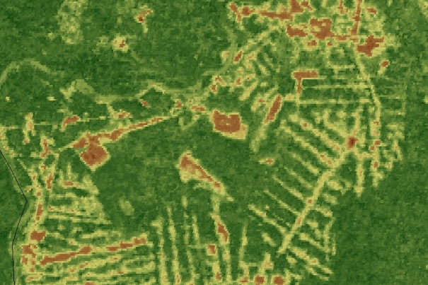
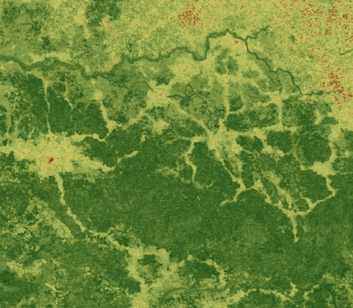
Pantropical Forest Carbon Mapped with Satellite and Field Observations
Baccini et al. 2012
Amazon Basin detail from the map
DRC detail from the map
PNG detail from the map
Error 25 Mg C ha⁻¹
Error 19 Mg C ha⁻¹
Error 24 Mg C ha⁻¹

Slide 7
West, PNNL
Objectives: Estimate uptake and release of cropland carbon globally
Resolution: useful for global analyses, but with accuracy needed for regional analyses.
Algorithm: Combine multiple national inventories with remote sensing and other spatial data. Distribute summed NPP, harvested amount, above- and below-ground biomass to reconciled land areas for 2005-2010. Bottom-up methods used to estimate human and livestock consumption
Output: global gridded cropland cover and fluxes
Spatial Domain & Resolution: Global, 0.05 degree
Time Period: 2005-present
Evaluation: inventory data from FAO/FAS

Slide 9
Denning, Haynes, Baker (CSU)
Objective: Develop a self-consistent suite of hourly GPP and Ecosystem Respiration and monthly biomass using SiB4, for use as a prior flux field in the CMS Flux Pilot Product.
Inputs: MERRA hourly reanalysis of surface weather, MODIS distribution of plant-functional types.
Algorithm: radiative transfer, gas exchange, and enzyme kinetic calculation of GPP. Allocation of photosynthate to cascading pools of respiring and decomposing biomass. Equilibrium spinup followed by disturbance from land-use and fires.
Output: Global hourly GPP and Resp on a 0.51-degree grid. Global monthly above-ground biomass for each of 15 plant-functional types on the same 1-degree grid.
Spatial Domain & Resolution: Global, 1-degree
Time Period: 2000-present
Evaluation: NEE vs flux towers; simulated CO2 using GEOS-Chem vs in-situ, TCCON, and GOSAT, above-ground biomass vs CMS Biomass product, GPP vs GOSAT Fluorescence

Slide 10
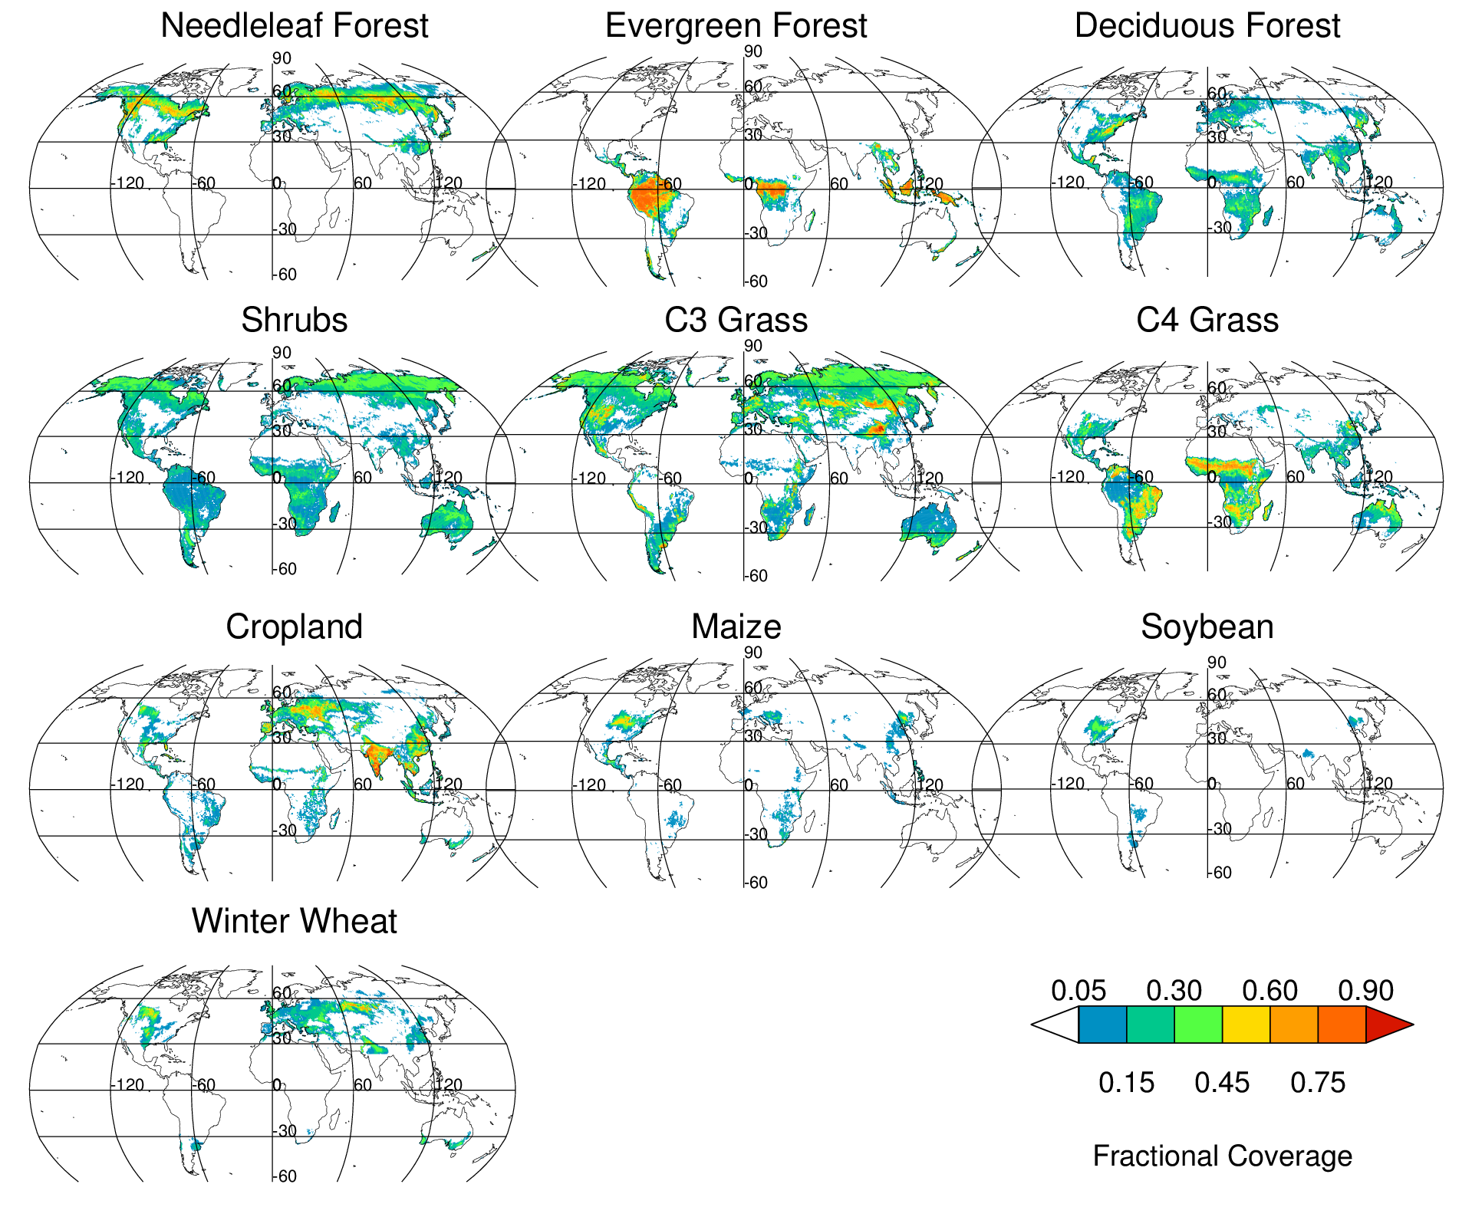
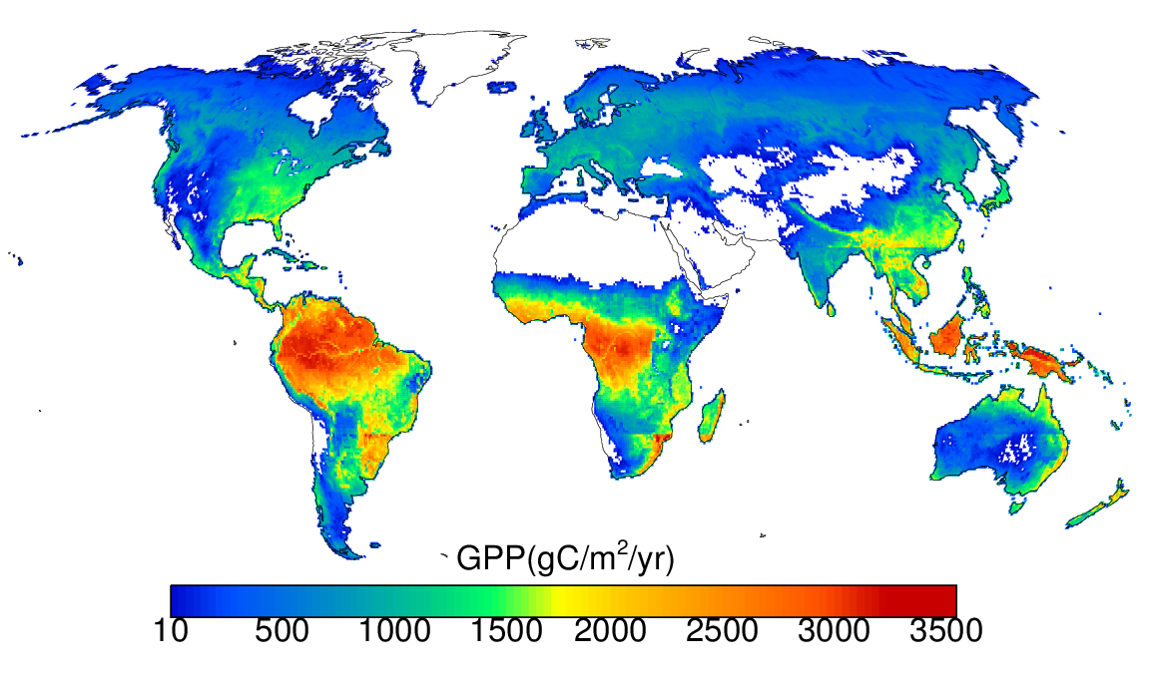
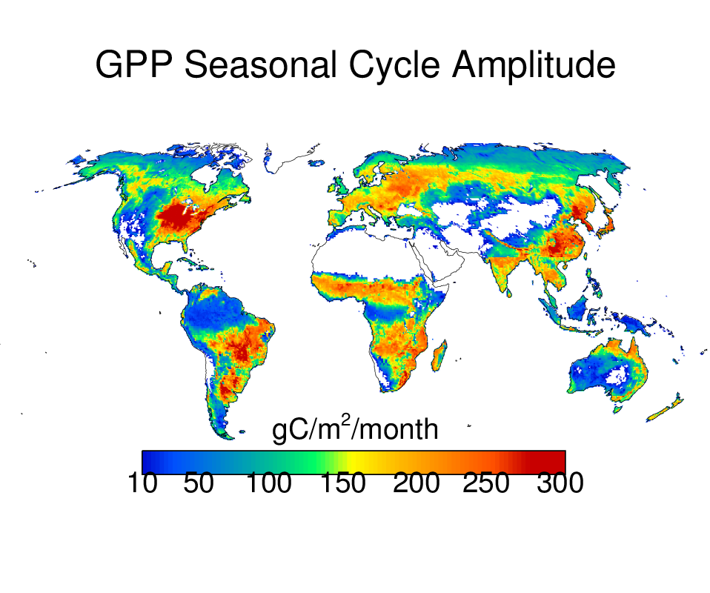
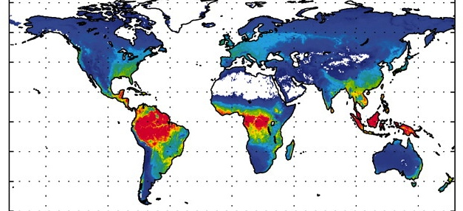
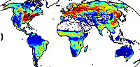
Joint Prediction of GPP, RESP, Fluorescence, LAI, and Biomass with SiB4
Seasonal Amplitude GPP
SiB4
SiB4
GPP
Dt = 15 min
Beer
2010
Jung
2011
Fractional coverage by 22 PFTs in every 0.5° x 0.5° grid
LAI
GPP
RESP
Biomass
Crop production
Fluorescence
Eval vs MODIS
GOSAT
CO2 etc
GEOS-
Chem
CMS Flux
Product
MERRA weather
SiB4
MODIS veg map
CMS
Biomass
Eval vs USDA
Eval vs GOSAT
Self-consistent prediction of fluxes and biomass with prediction of multiple satellite products

Slide 11
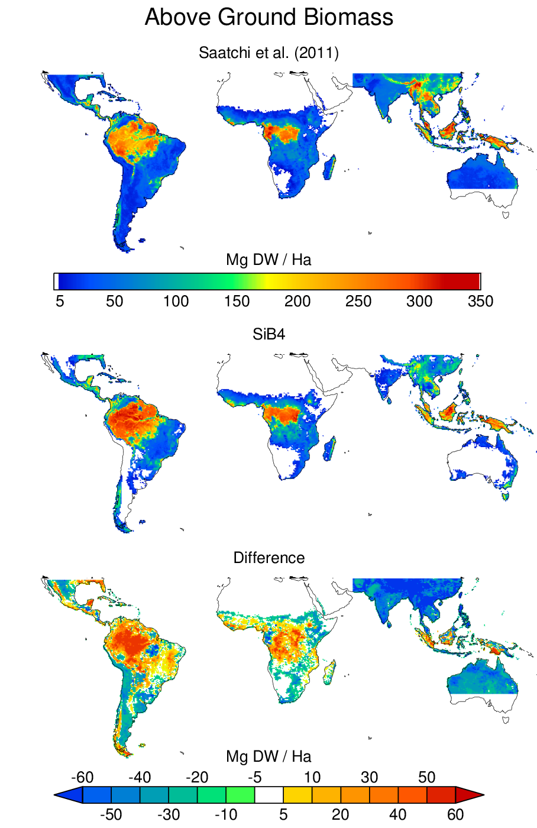
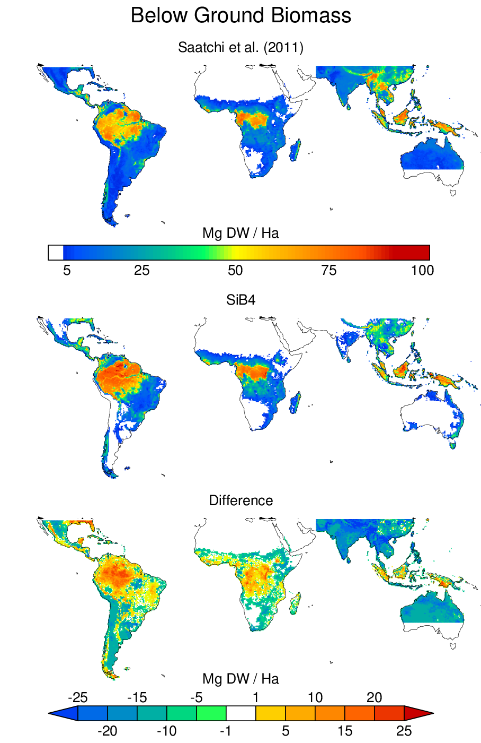
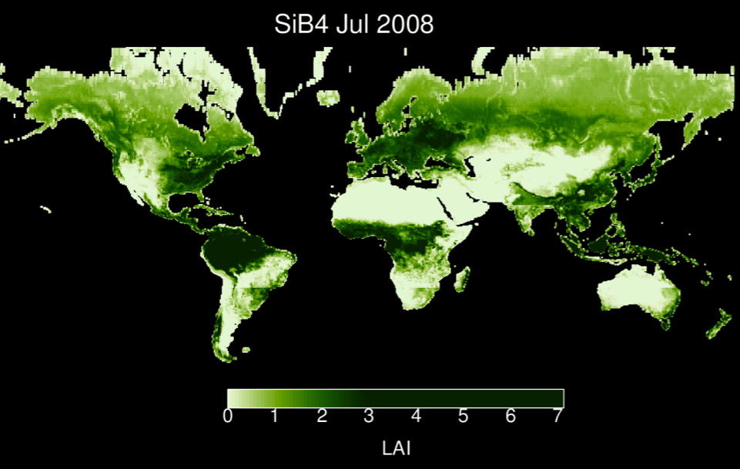
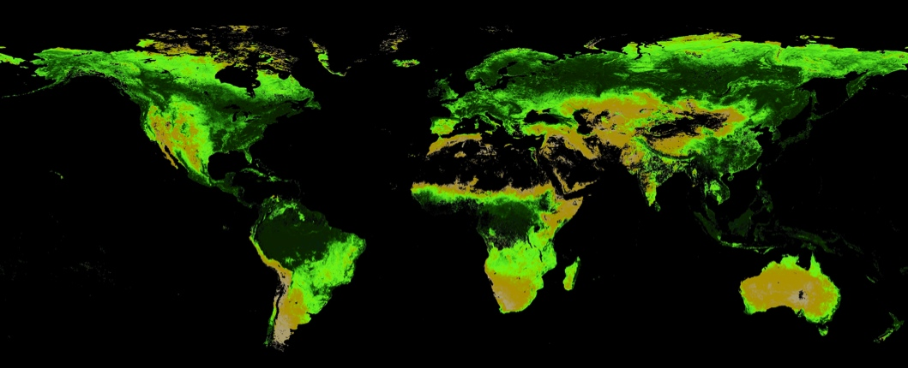
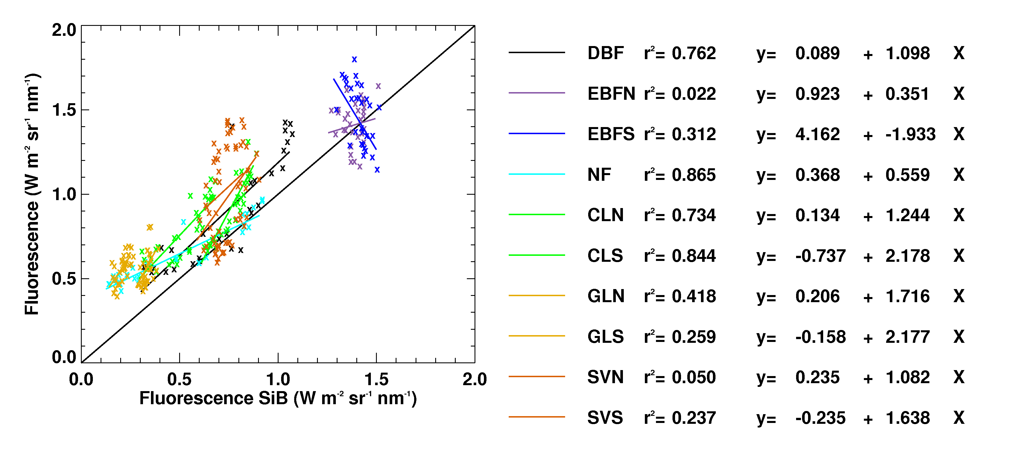
SiB4 LAI, Biomass, & Fluorescence
SiB4
LAI
MODIS
Chlorophyll Fluorescence
1:1
GOSAT
Biomass in tropics overestimated a bit
Subtropics underestimated a bit
Fluorescence is a bit too weak in dry places
SiB4

